Slide 1
SITK® CA for LabVIEW™
Camera only Advanced edition
For Q-Imaging cameras

Slide 2
First install PVCAM
Current version supported is v2.7.9.1 32-bit

Slide 3
Install SITK® CA for LabView
Either from CD or Download.

Slide 4
Preliminary screen to briefly explain how to use the
“global handle” scheme

Slide 5
Welcome Screen
Shows software name and version

Slide 6
Standard software license agreement

Slide 7
Select where the examples, documentation and registration files will be installed.
Other files are installed into the LabVIEW folder.

Slide 8
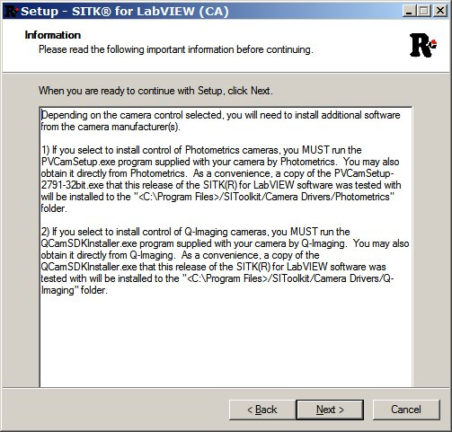
Make sure to install the camera drivers before running

Slide 9
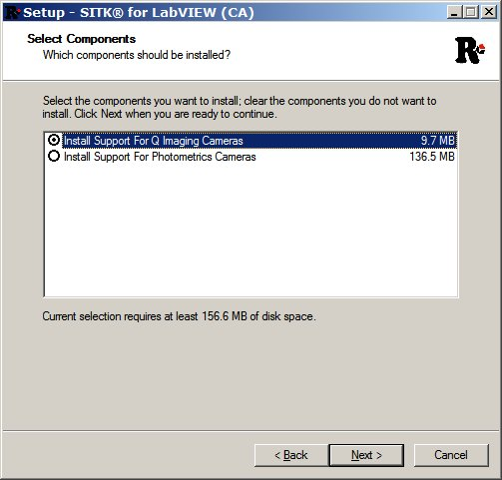
Select the camera type to be supported.
Only one type may be selected.

Slide 10
Select the versions of LabVIEW that are installed and for which the SITK® is to be integrated.
If you have one, select support for the USB dongle key

Slide 11
Review your installation selections and click “Install” to start unpacking and copying files.

Slide 12
During installation, an status page will be displayed with a progress bar.

Slide 13
If support for a dongle key was selected, the installation of its drivers will be run. Follow the directions in the install until it is completed.

Slide 14
The SITK® software comes with a 1 year warranty that includes free technical support and upgrades. After that time, a reasonably priced Support and Maintenance Subscription may be purchased.

Slide 15
The installation is complete.

Slide 16
Registration of the SITK® software is required in order to receive a license file. A license file is required for every computer, even when using the software on a trial basis.

Slide 17
Now let’s test the camera. Please turn on the camera, and run LabView. We support LabView versions from 6.1 to the current version

Slide 18
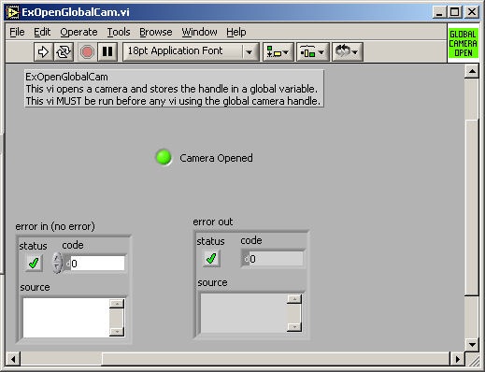
Next let’s try to open the camera. You need to do this once when entering LabView, but don’t need to do it again as long as you don’t close the camera.
From the folder
“program files\SIToolKit\LabVIEW\ExamplesXX_3_1_1_0\Open-Close”, select ExOpenGlobalCam.vi. Run the program by pressing the arrow key. The camera Opened LED should light up.

Slide 19
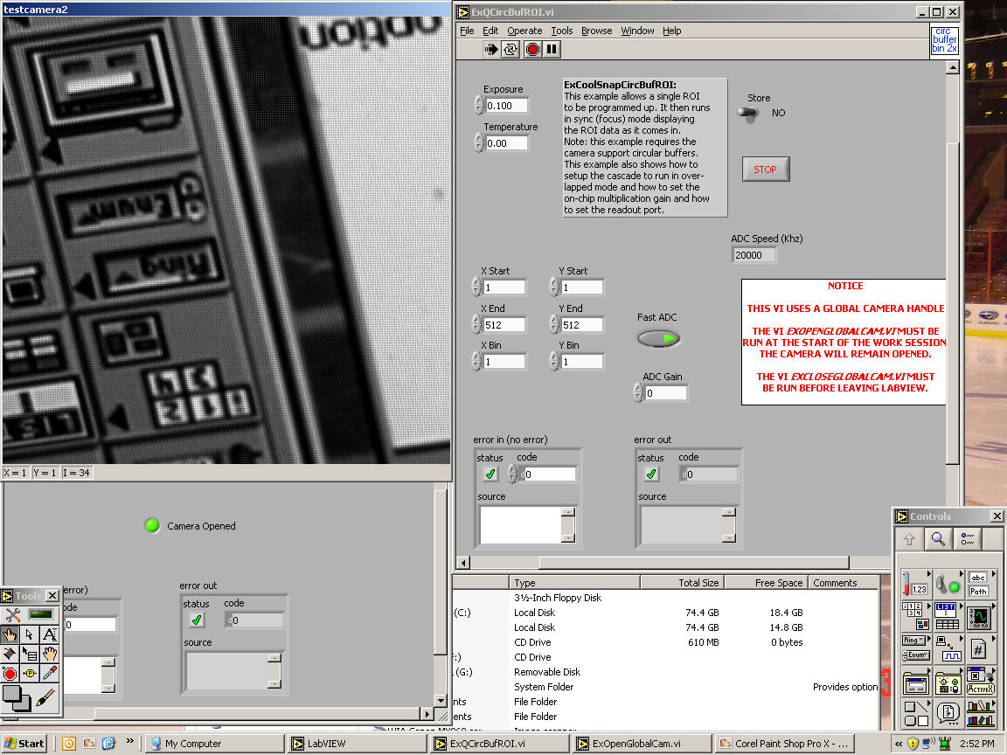
Once the camera is open, try running one of the camera data collection examples. Go to the Q-Imaging folder for examples using the Q-Imaging cameras , then run ExQCircBufROI.vi. You can rerun this as much as you want or run other data collection examples. Hit the stop button on the examples panel to stop the example cleanly. Note: set the data collection parameters before running the example

Slide 20
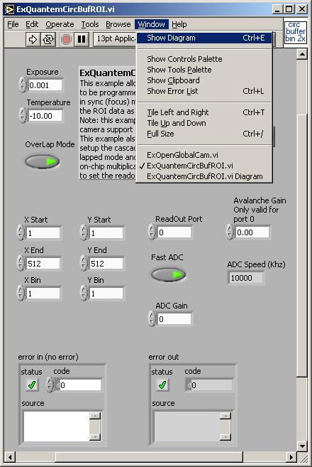
Open Diagram to view code
Go to Window and select Show Diagram at top of example VI

Slide 21
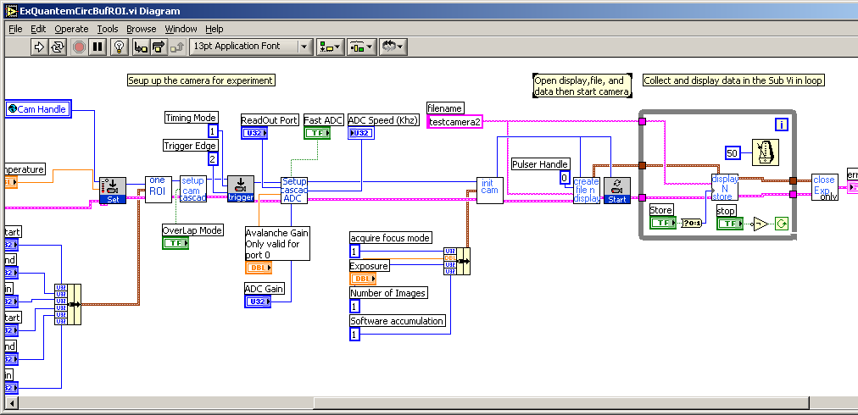
Diagram of example

Slide 22
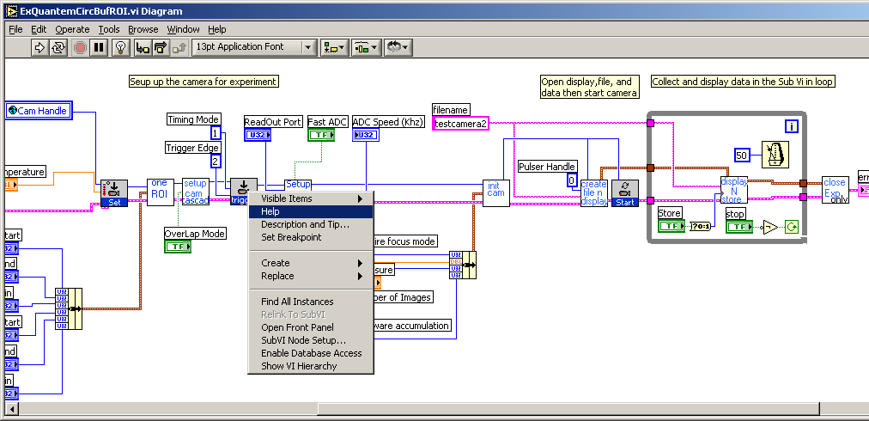
Online help
Right click on VI and select help
Right click on trigger VI and select help

Slide 23
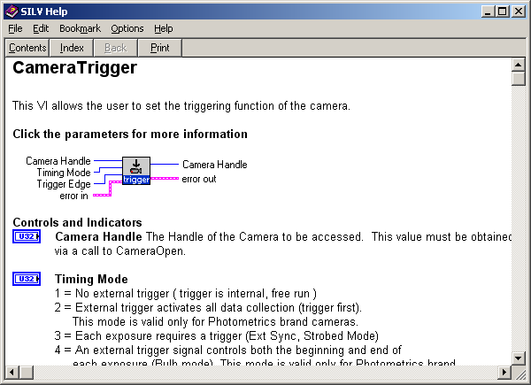
Online help
All SITK® palette VI’s have online help

Slide 24
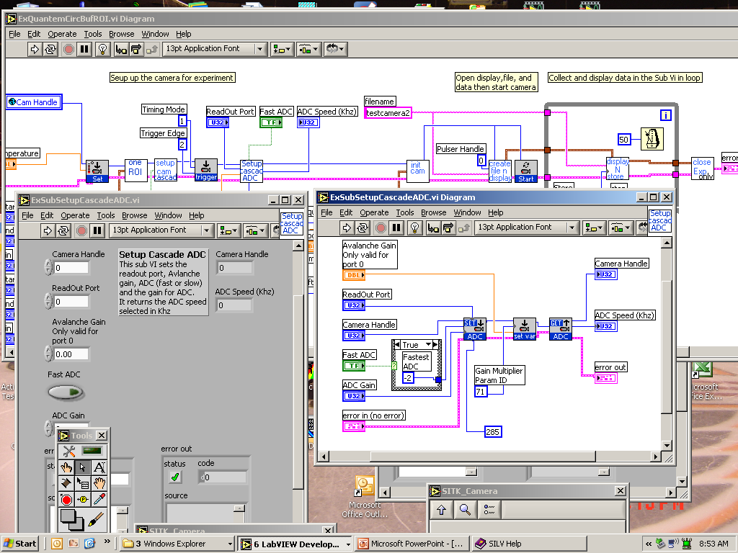
You can open a sub-vi
SITK® Sub vi’s have the name ExSubName.vi.

Slide 25
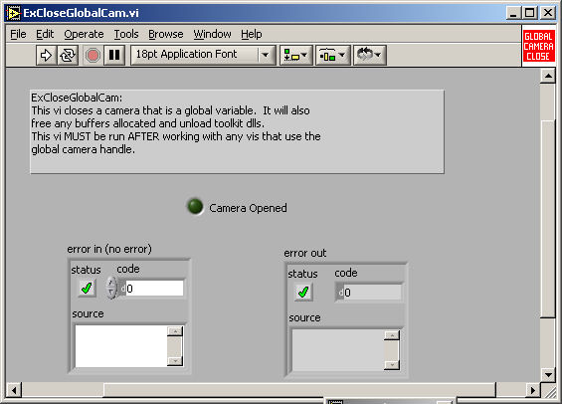
Before leaving LabVIEW close the toolkit and camera by running ExCloseGlobalCam.vi which can be found in the Open-Close folder of the examples. This closes the low level camera drivers.

